Slide 1










THE NATIONAL OUTBREAK REPORTING SYSTEM (NORS)
ZAINAB QAMBER - DAB6
BUSHRA MAARAJ - DAB6

Slide 2

TODAY, WE WILL EXPLORE..
3- Common Transmission Mode
4- Outbreak Etiologies Over Time (1998-2023)
1- Outbreak Trends by Year (1998-2023)
2-Top 10 States with the Highest Number of Outbreaks
7- Top Animals Type in Common Transmission Mode
5- Hospitalization vs. Death
6- Top Food Vehicles Involved in Outbreaks

Slide 3
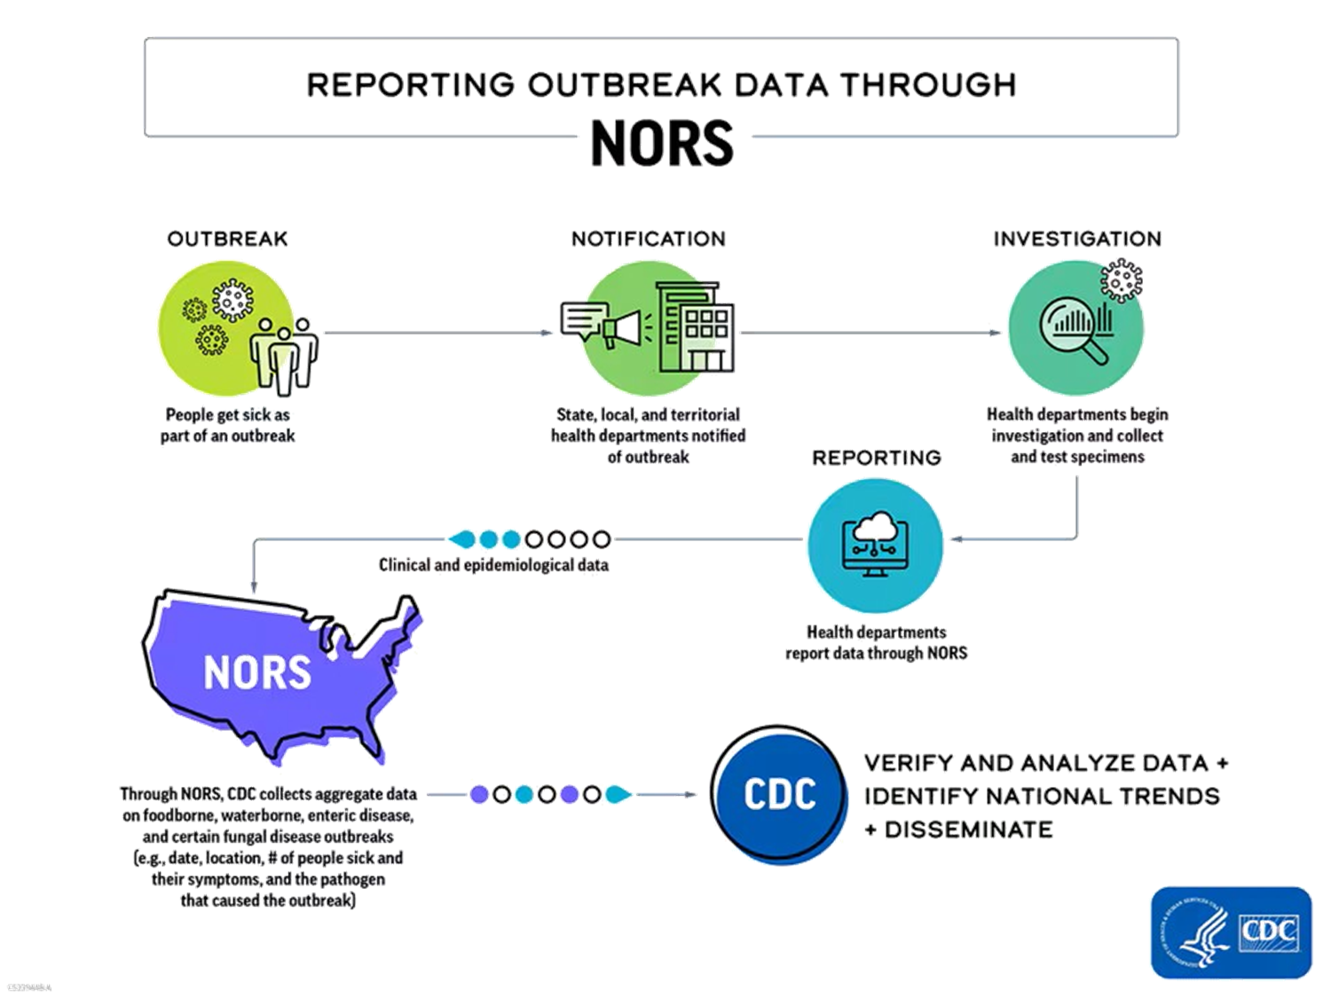



Slide 4



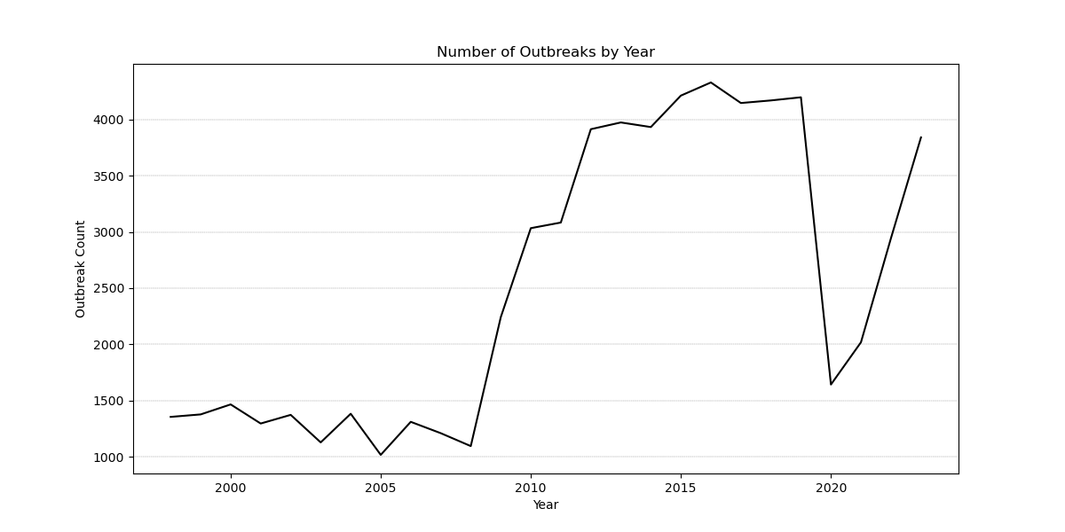

Outbreak Trends by Year (1998-2023)

Slide 5

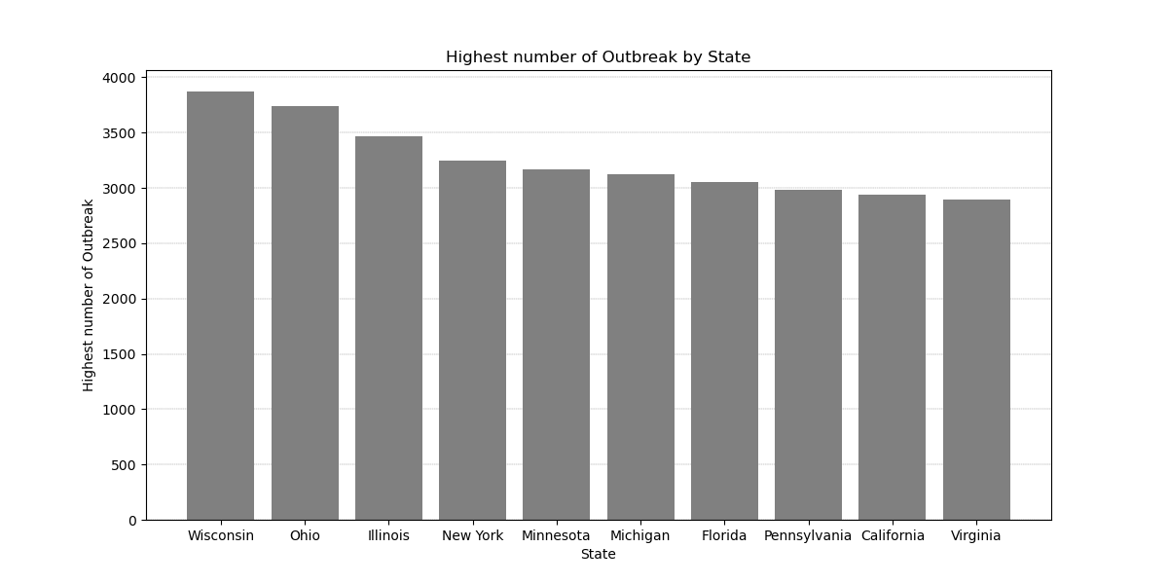
TOP 10 STATES WITH THE HIGHEST NUMBER OF OUTBREAKS

Slide 6


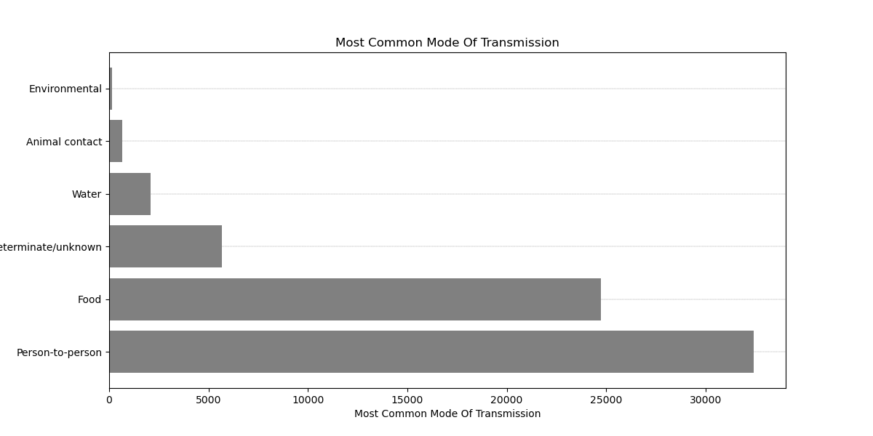


COMMON TRANSMISSION MODE

Slide 7

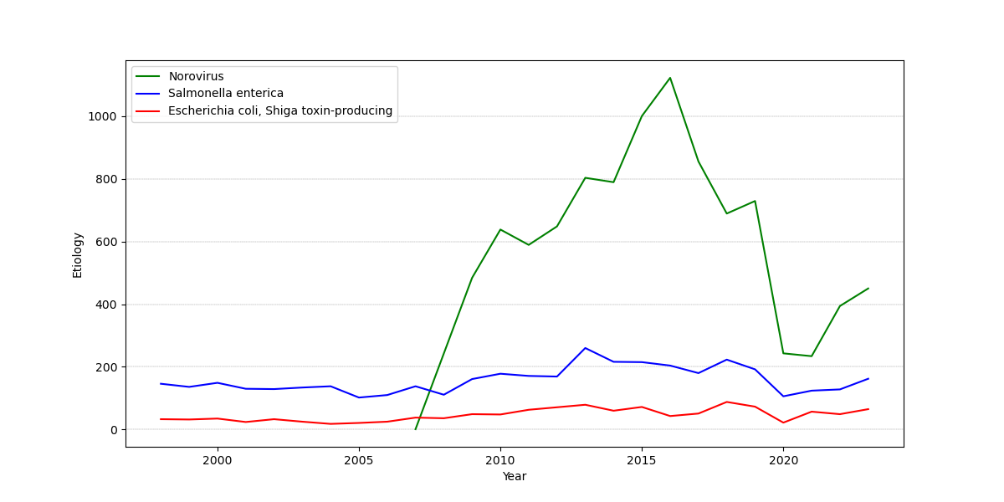
Outbreak Etiologies Over Time (1998-2023)

Slide 8
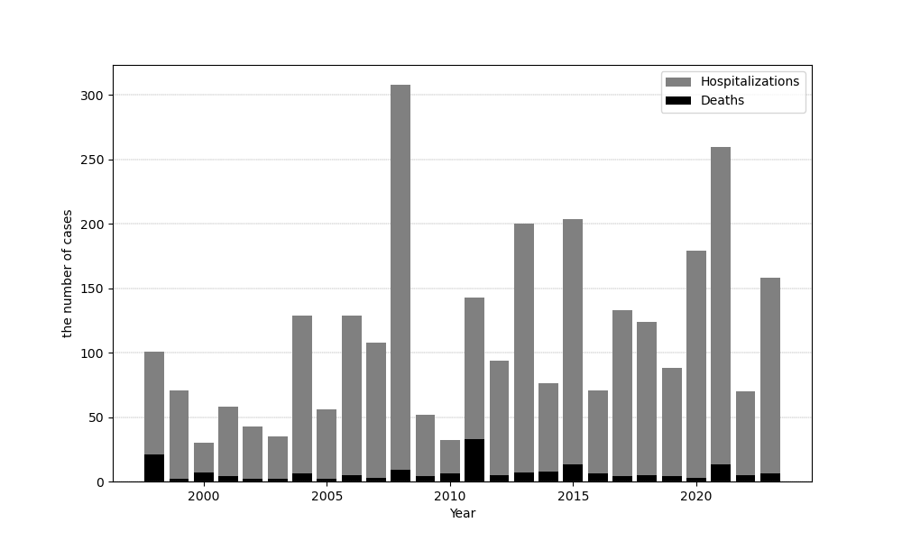
HOSPITALIZATION VS. DEATH

Slide 9
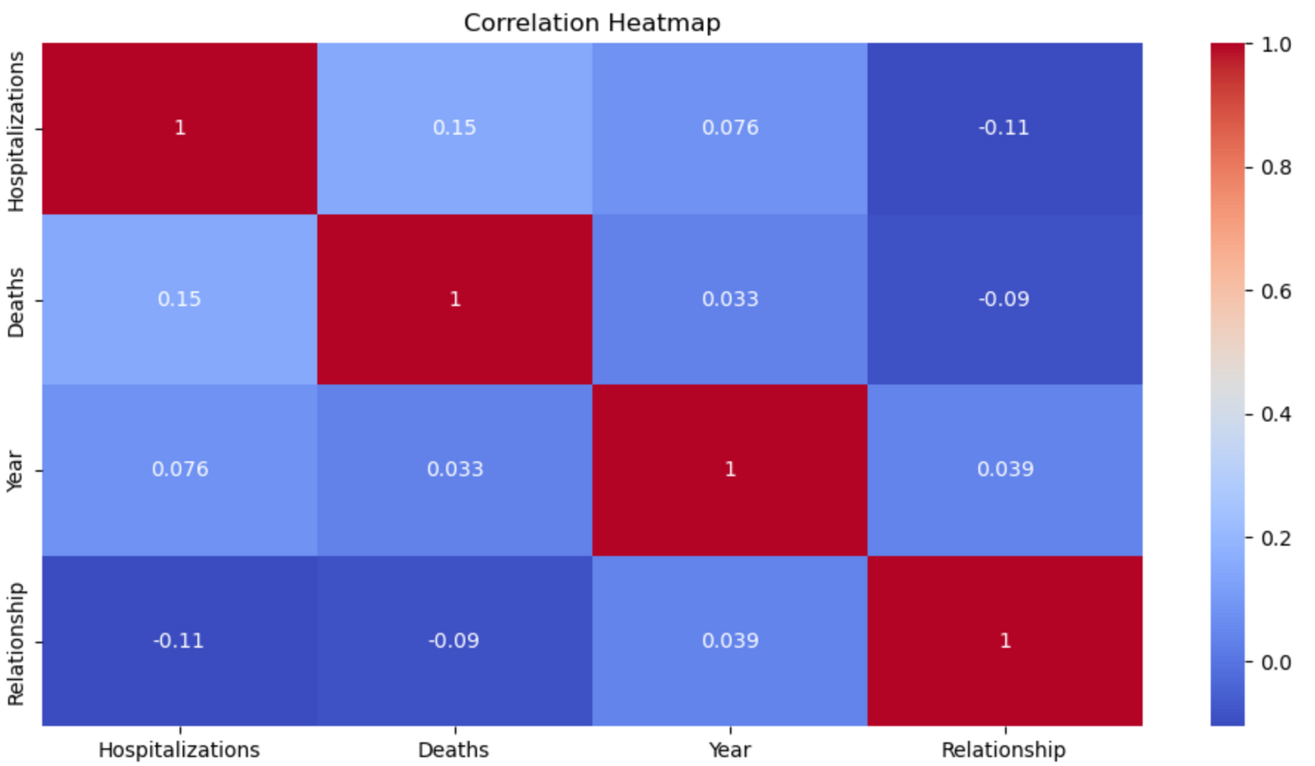
HOSPITALIZATION VS. DEATH

Slide 10

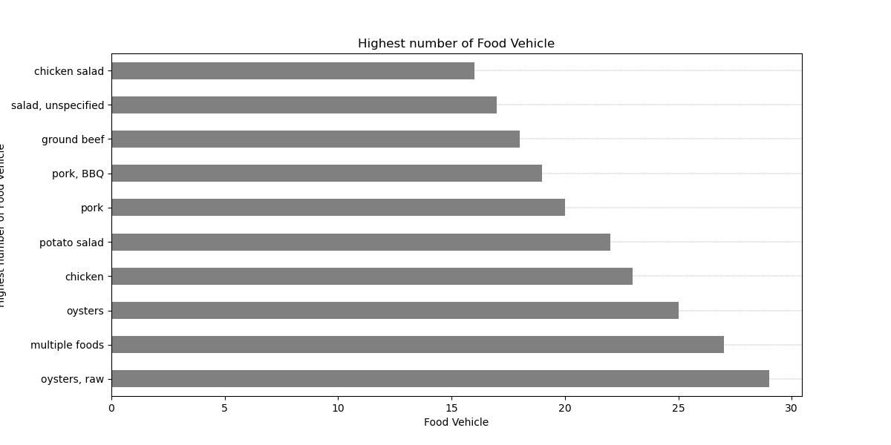

TOP FOOD VEHICLES INVOLVED IN OUTBREAKS

Slide 11
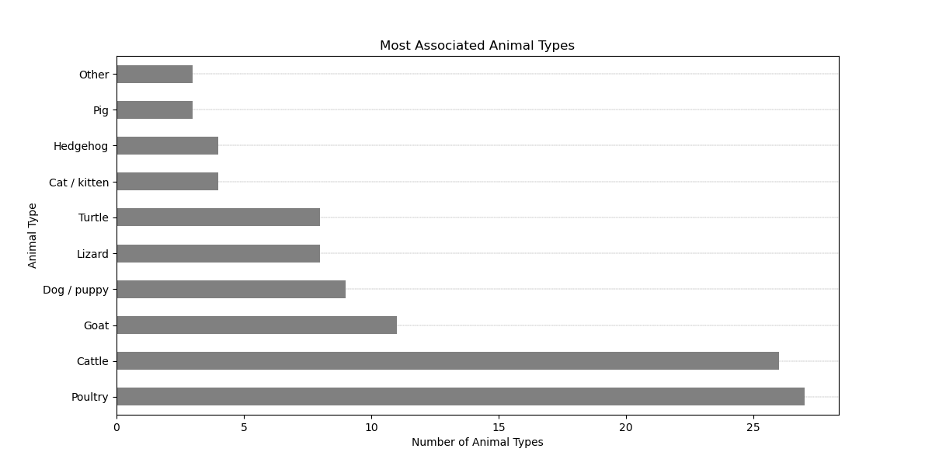
ANIMALS OUTBREAKS

Slide 12







THANK YOU FOR YOUR ATTENTION!!

